Slide 1
The Distinctive Intelligence of Young Children: Insights for AI from Cognitive Development

Slide 2
“Instead of trying to produce a programme to simulate the adult mind, why not rather try to produce one which simulates the child's?” Alan Turing, 1950.

Slide 3
Life History and The Evolution of Childhood
Notes:
Length parental investmenttriple threat

Slide 4
Comparative Evidence: Life History, Brain Size and Learning
Notes:
Birds mammals, insects

Slide 5
Exploitation vs. Exploration Trade-Offs

Slide 6
Simulated Annealing
Low-temperature search
Quick to settle on high-probability answer
May miss low-probability answer
High-temperature search
Slow to settle on high-probability answer
More likely to find low-probability answer

Slide 7
Hypothesis
Childhood is evolution’s way of resolving explore/exploit trade-offs and performing simulated annealing.
Notes:
ADD LAST SLIDE!!!!!!!!

Slide 8
Adult Intelligence Vs. Child Intelligence
Adult Cognitive Psychology: Inference, Attention, Planning, Decision-Making
Child Cognitive Development: Statistical Learning, Grammar Induction, Intuitive Theory Formation, Conceptual Change

Slide 10
The Theory Theory 2.0 Bayesian Inference of Probabilistic Models Gopnik, Science 2012; Gopnik & Wellman Psychological Bulletin, 2012
Four year olds (and younger) can rationally
Infer complex causal structure from conditional probabilities
Integrate and override prior knowledge in the face of new evidence
Infer unobserved structure
Infer abstract hierarchical over-hypotheses
Infer theories of the physical, biological and psychological domains
Etc. etc. etc.

Slide 11
The Search Problem

Slide 12
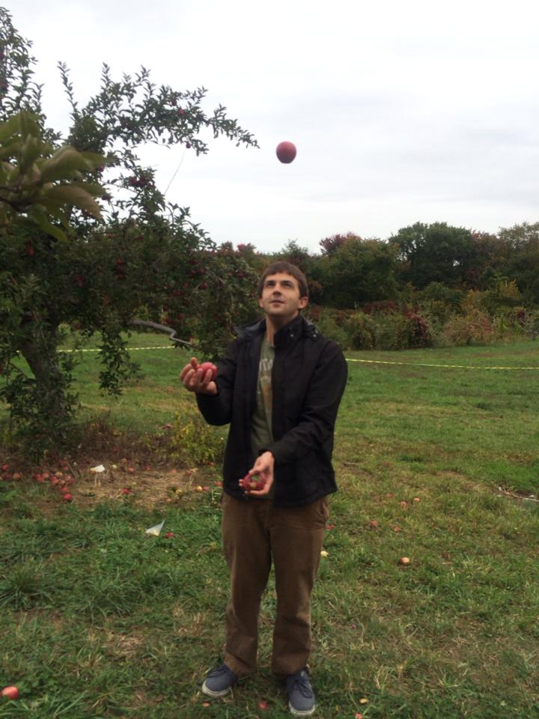
When Younger Learners are More Exploratory
A. Gopnik, T. Griffiths, & C. Lucas (2015). Current Directions in Psychological Science, 24 (2), 87-92
C. Lucas, S. Bridgers, T. Griffiths, & A. Gopnik (2014). Cognition. 131, 2, 284–299.
A. Gopnik, S. O’Grady, C. Lucas, T. Griffiths A. Wente, S. Bridgers, R. Aboody, H. Fung, R. E. Dahl, (2017). PNAS.

Slide 13
Which objects are blickets?
Is D a blicket? Is E a blicket? Is F a blicket?

Slide 14
What if you also saw these events?

Slide 16
Disjunctive Training
Conjunctive Training
Test

Slide 17
Gopnik et al. PNAS, 2017 Proportion of Participants Choosing the Unlikely Physical Hypothesis (D)
Evidence for Unlikely
No Evidence
Evidence for Likely
Notes:
90 6-7 , 90, 86 12-14, 90 9-11 year olds – sig differences between 4 and all others, 6, 9 and 12 adult, Peru and head start

Slide 18
Other Examples Where Younger Learners Are More Exploratory
Learning relational vs. individual concepts: Walker et al. Cognition 2016
Learning traits vs learning situations (Seiver et al.2013, Gopnik et al. 2017).
Learning foreign language vs. own language distinctions (Kuhl 2004,Werker, 2015).
Learning novel vs. familiar artifact uses. (German & Defeyter, 2000).
Learning unattended stimuli (Sloutsky, 2017)

Slide 19
Experimentation, Exploration and Explanation

Slide 20
Children as Exploratory Searchers: Bugs may be Features
Noisiness, variability, randomness
Executive function deficits
Play: Exploratory and pretend
Epistemic versus reward motivation (Pathak et al. ICML 2017)

Slide 21
Computational Features of Children as Exploratory Searchers
Higher temperature
Broader proposals
Flatter priors
Epistemic utility functions

Slide 22
Collaborators and Support
Tom Griffiths
Chris Lucas
Clark Glymour
Caren Walker
Stephanie Denison
Elizabeth Bonawitz
Shaun O’Grady
NSF
The McDonnell Foundation Causal Learning Collaborative
The Bezos Foundation

